Slide 1
2015 Annual Report
ADVOCATE • EDUCATE • CELEBRATE

Slide 2
Our Mission
The San Diego County Bicycle Coalition advocates for and protects the rights of all people who ride bicycles. We promote bicycling as a mainstream, safe and enjoyable form of transportation and recreation.

Slide 3
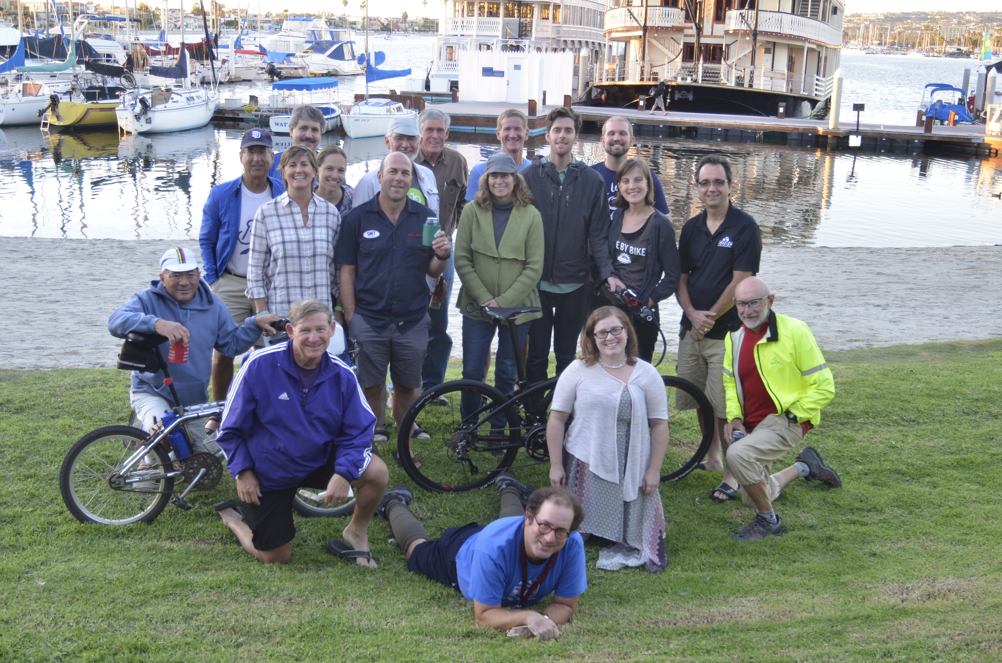
2015 SDCBC BOARD Of Directors
Kevin Wood, Chair
Judi Tentor, Vice-Chair
Maria Olivas, Secretary
Carrie Stemrich, Treasurer
Khalisa Bolling, Advocacy
Howard LaGrange, Regional Bike/Walk Alliance
Jim Baross, Education
Board Members:
Serge Issakov
Randy Van Vleck
Elayne Fowler
Myles Pomeroy
Stephan Vance
David Nichols
Robert Leone
Travis Pritchard
ADVOCATE • EDUCATE • CELEBRATE

Slide 4
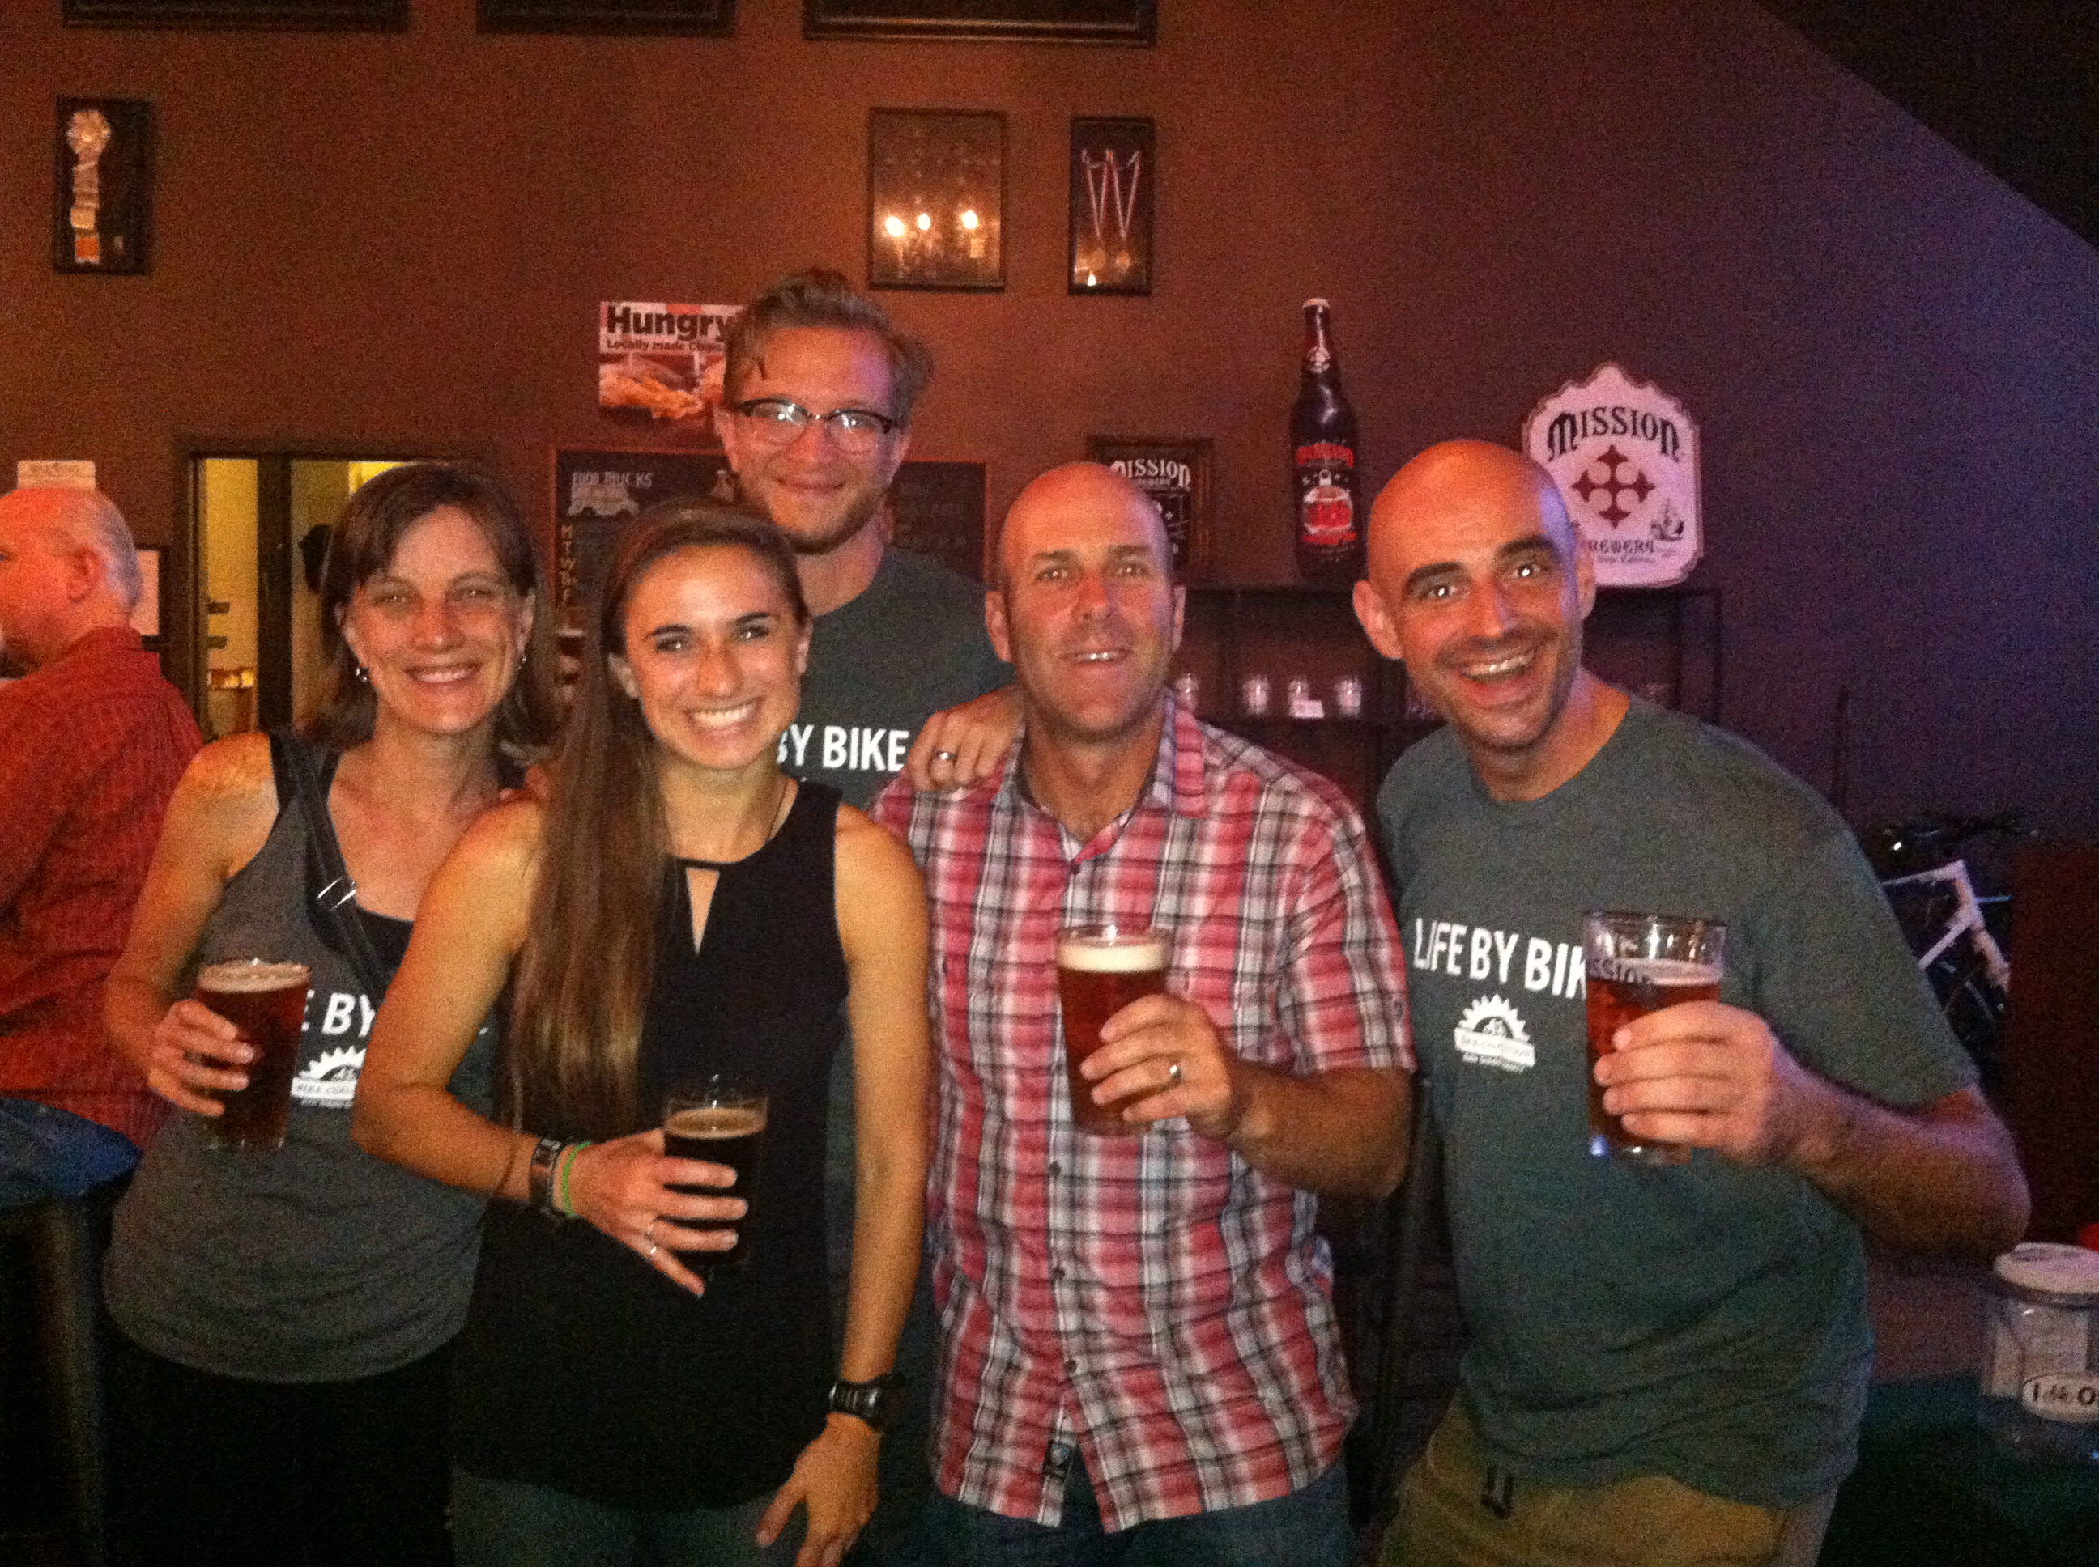
SDCBC STAFF
Michelle Luellen, Erin Stephens, Kevin Baross, Andy Hanshaw, Corey Hart
ADVOCATE • EDUCATE • CELEBRATE

Slide 5
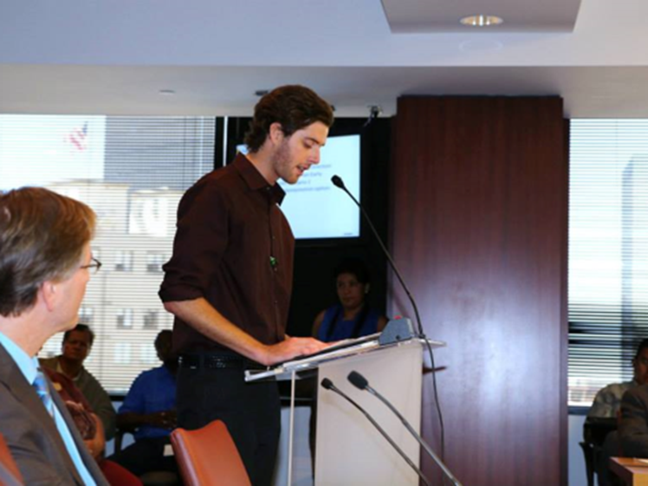
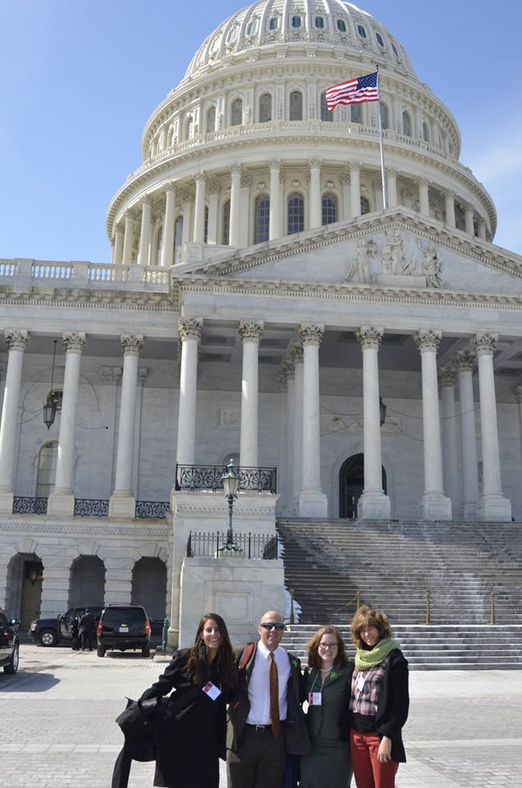
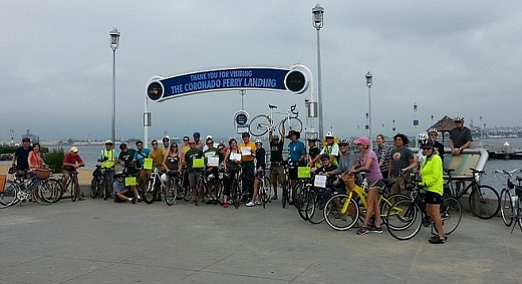
ADVOCATE
2015 Highlights
New Bike lanes added countywide
Attended dozens of regional meetings to advocate for safer, more accessible and connected bikeways
Advocated for transportation funding at federal, state, regional and local levels
Advocated for City of San Diego Climate Action Plan calling for 6% bicycle commute mode share by 2020 and 18% by 2035
Advocated for contiuned progress of regional bikeways in Uptown, North Park, Coastal Rail Trail and Bayshore Bikeway
ADVOCATE • EDUCATE • CELEBRATE

Slide 6
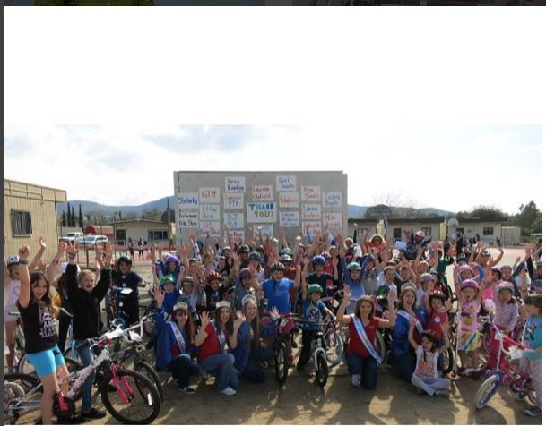
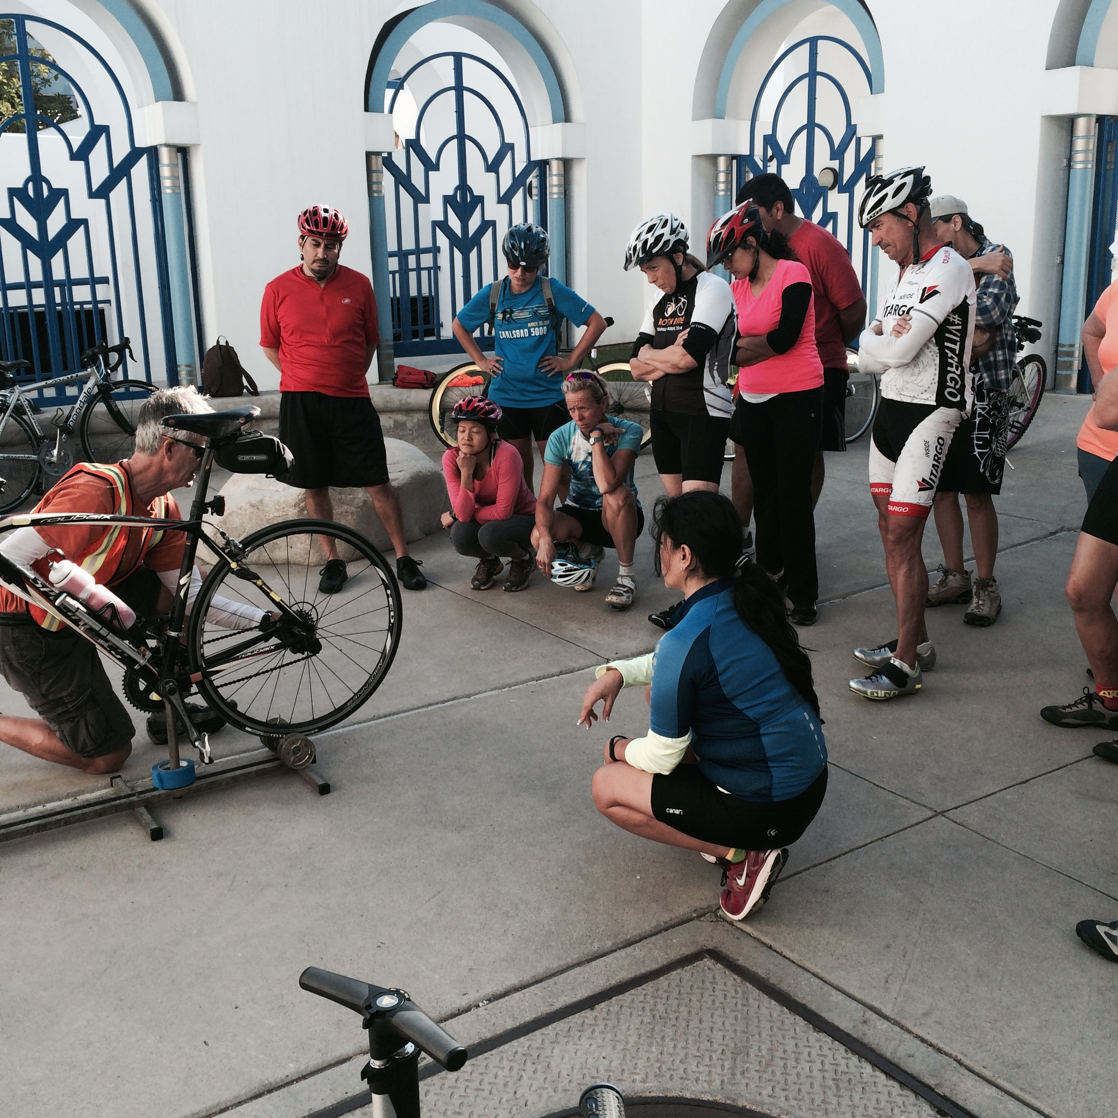
EDUCATE:
In 2015 we reached 4175 people (adults and children) through education programming from Oceanside to San Ysidro to Lemon Grove. We conducted dozens of Bike Rodeos, Community Bike Rides and Safety Assemblies
ADVOCATE • EDUCATE • CELEBRATE

Slide 7
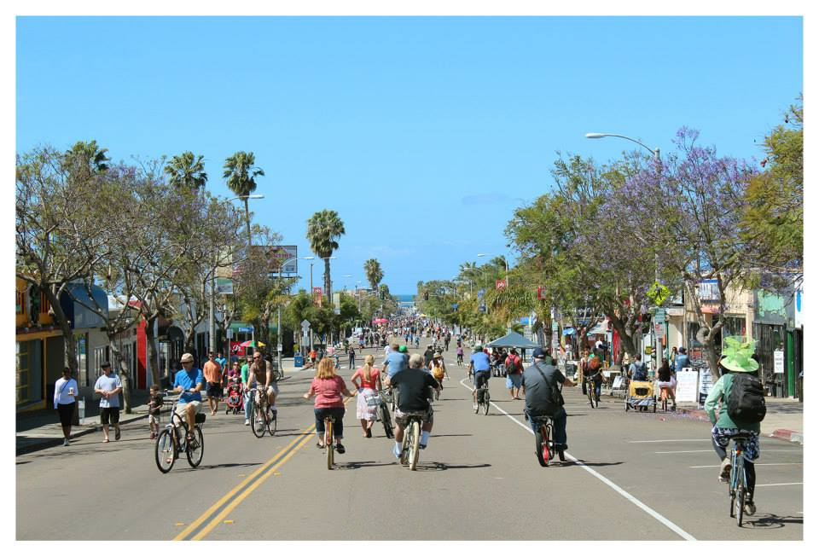
CELEBRATE

Slide 8
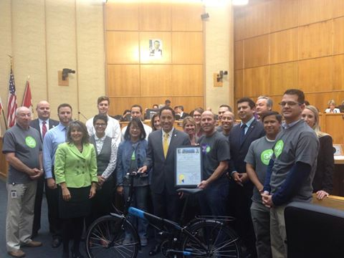
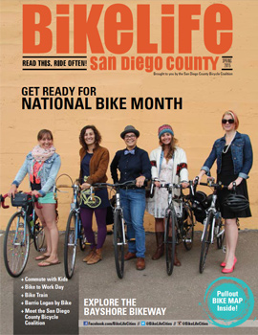
BIKE MONTH MAY 2015
BikeLife Magazine Launch
ADVOCATE • EDUCATE • CELEBRATE

Slide 9
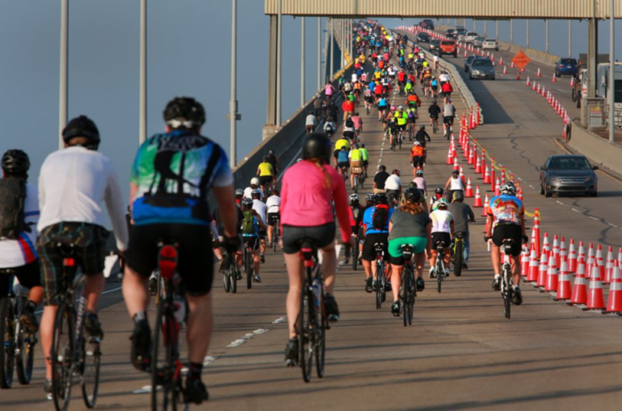
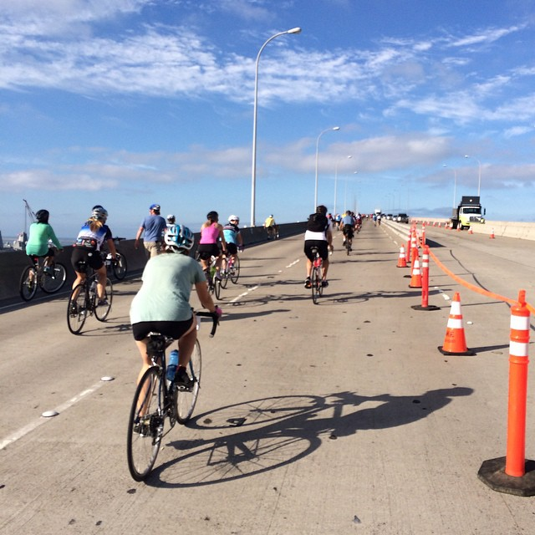
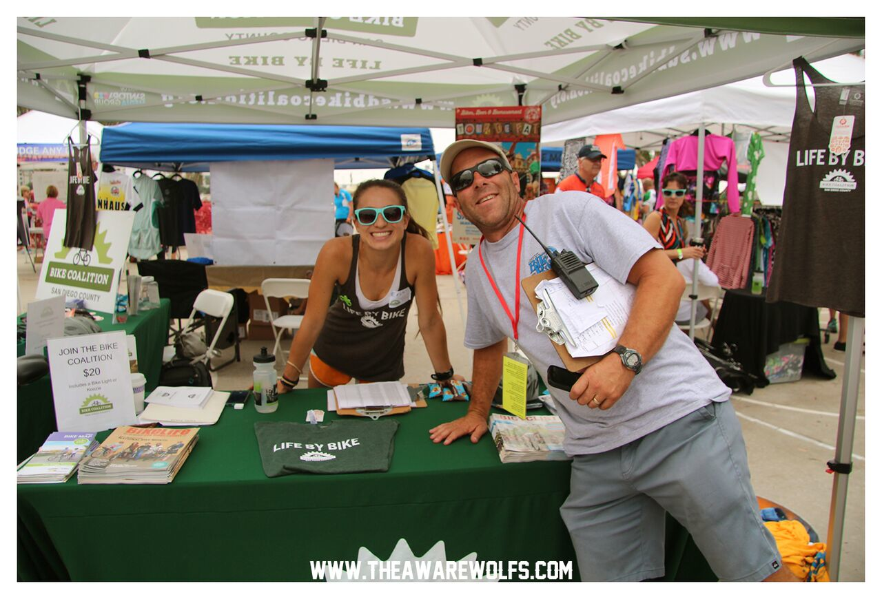
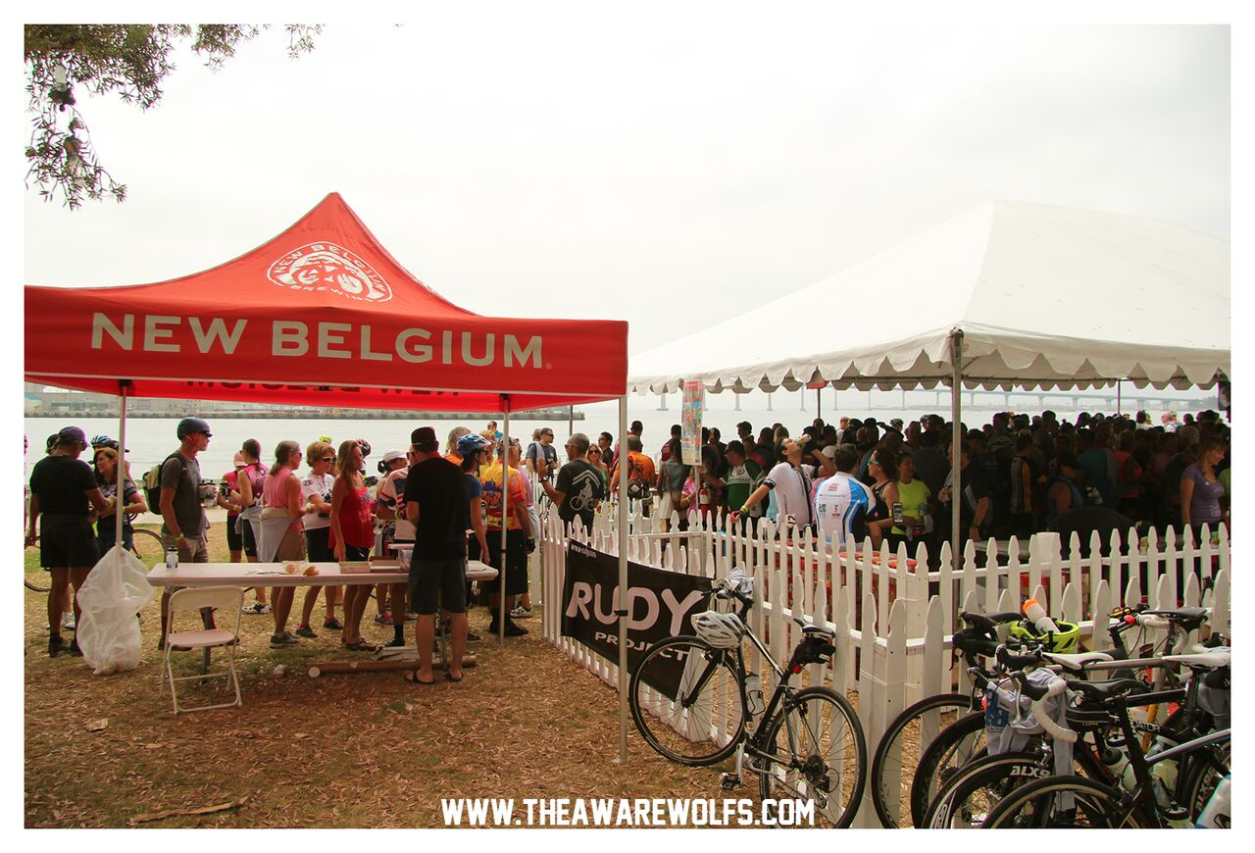
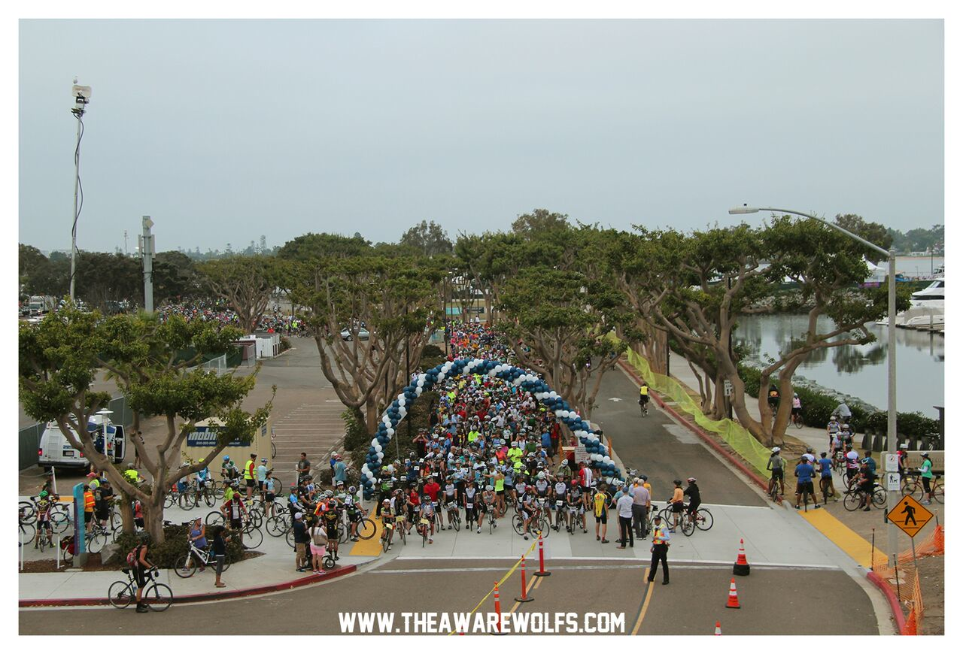
Raised $72,000 for SDCBC Programs at 8th Annual Bike The Bay
ADVOCATE • EDUCATE • CELEBRATE

Slide 10
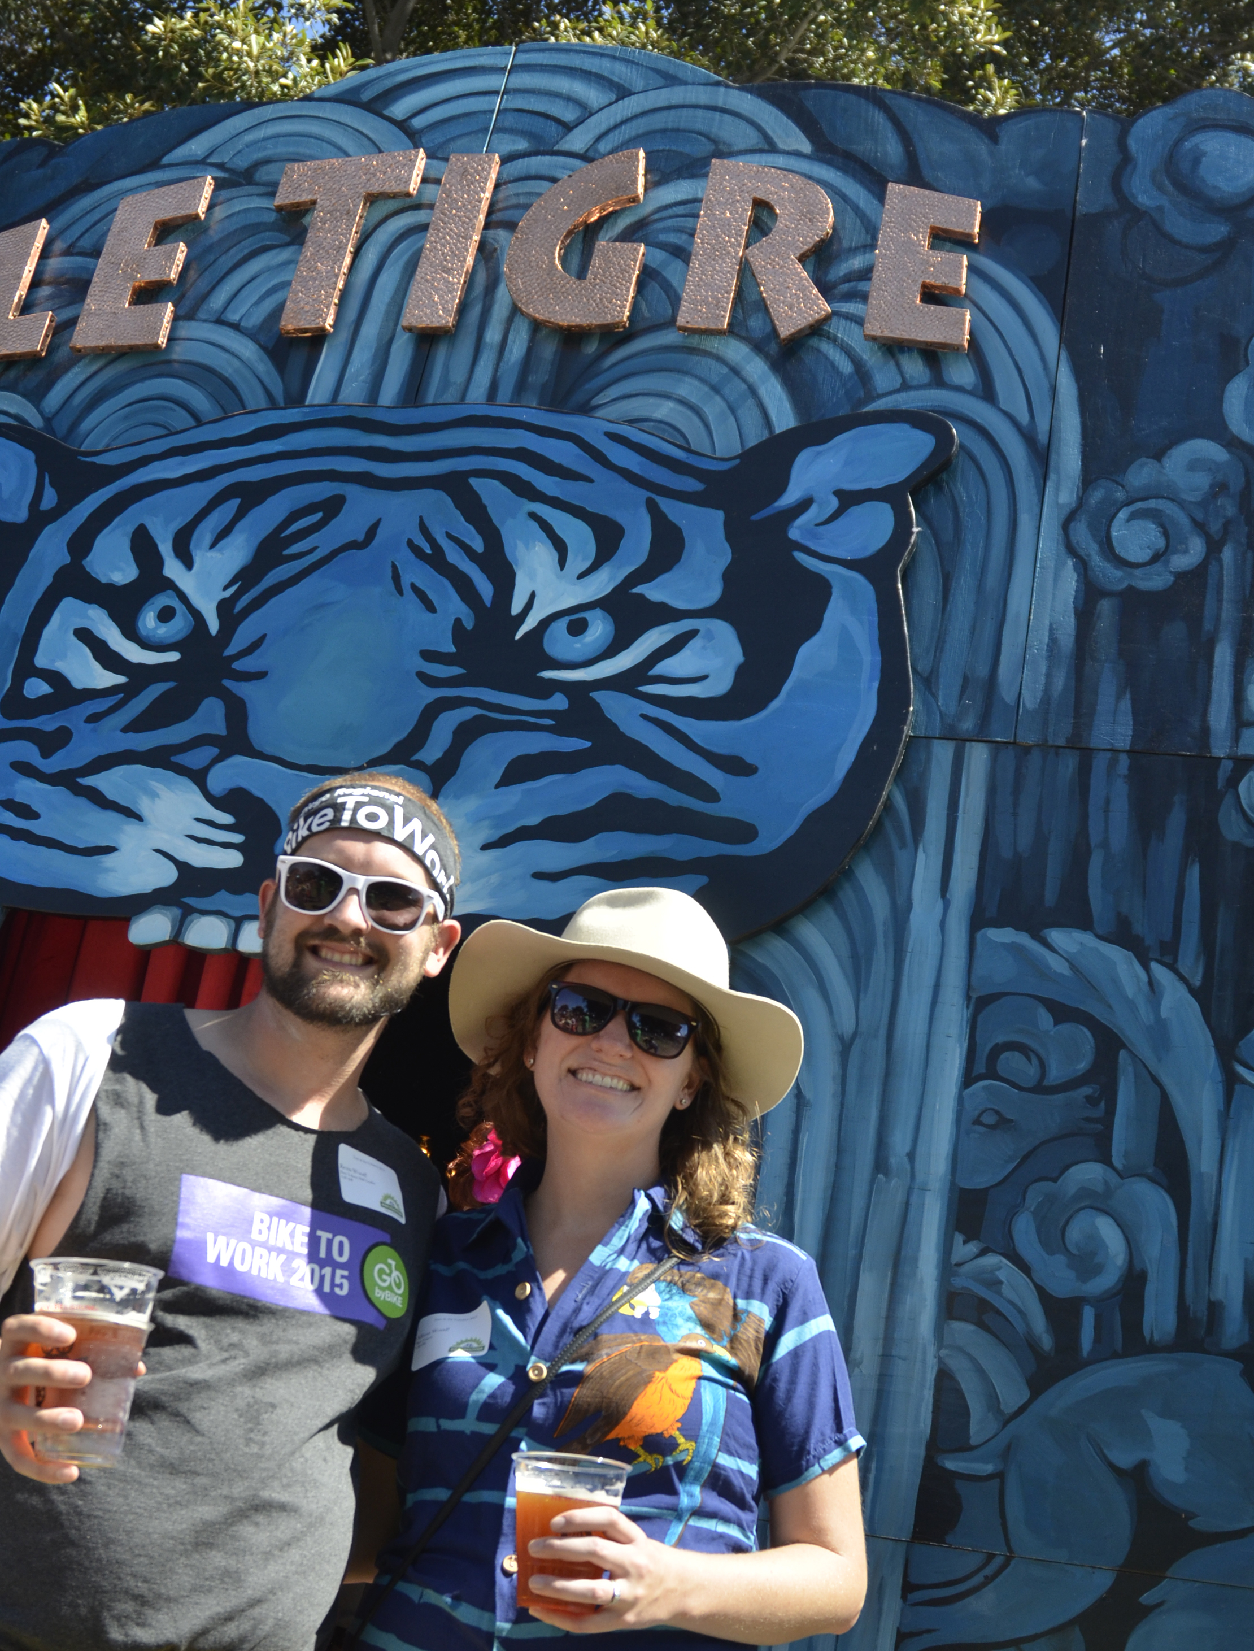
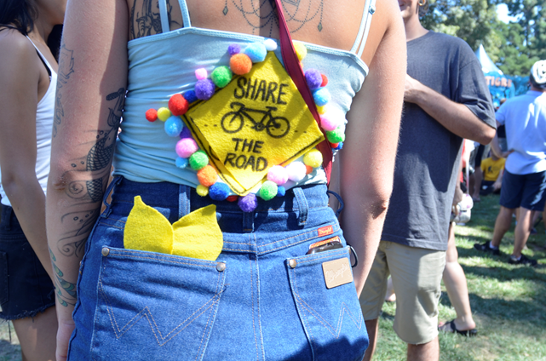
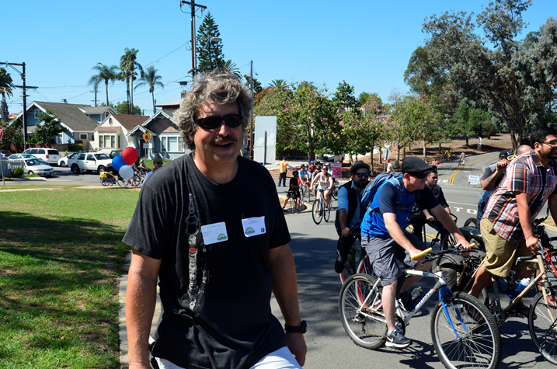
TOUR DE FAT
Raised $40,000 for SDCBC Programs
ADVOCATE • EDUCATE • CELEBRATE

Slide 11
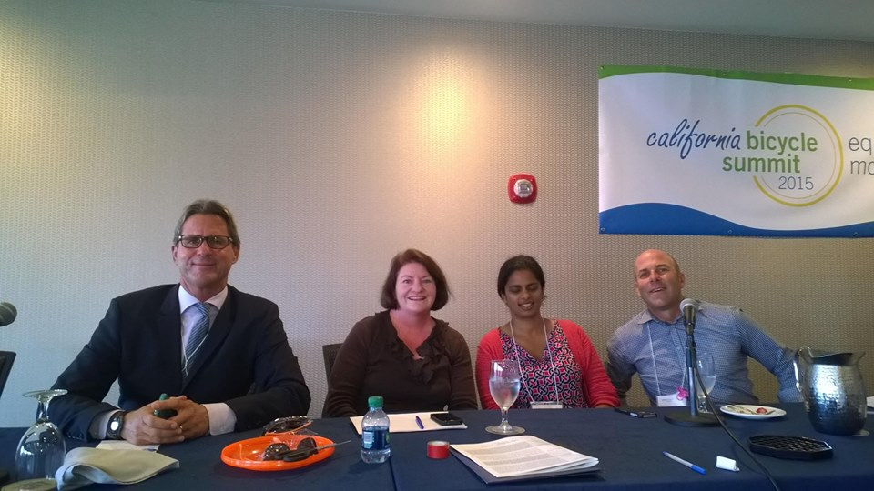
We Hosted STATE & NATIONAL MEETINGS
ADVOCATE • EDUCATE • CELEBRATE

Slide 12
GOLDEN GEAR AWARDS 2015 ADVOCATE OF THE YEAR
Monique Lopez
ADVOCATE • EDUCATE • CELEBRATE

Slide 13
GOLDEN GEAR AWARDS COMMUNITY PARTNER OF THE YEAR
REI
ADVOCATE • EDUCATE • CELEBRATE

Slide 14
GOLDEN GEAR AWARDS PUBLIC PARTNER OF THE YEAR
City of National City
ADVOCATE • EDUCATE • CELEBRATE

Slide 15
GOLDEN GEAR AWARDS BIKE FRIENDLY BUSINESS OF THE YEAR
TREK Bicycle Superstore
ADVOCATE • EDUCATE • CELEBRATE

Slide 16
GOLDEN GEAR AWARDS VOLUNTEER OF THE YEAR
Mike Samyn
ADVOCATE • EDUCATE • CELEBRATE

Slide 17
THANKS TO OUR SPONSORS
ADVOCATE • EDUCATE • CELEBRATE

Slide 18
2015 Financials
Financial Support total: $350,145
Events: $131,867
Grants $171,510
Membership $17,488
Gifts $29,280
Expenses total: $310,536
Membership& development $78,624
Programs $150,177
Operations $81,735

Slide 19
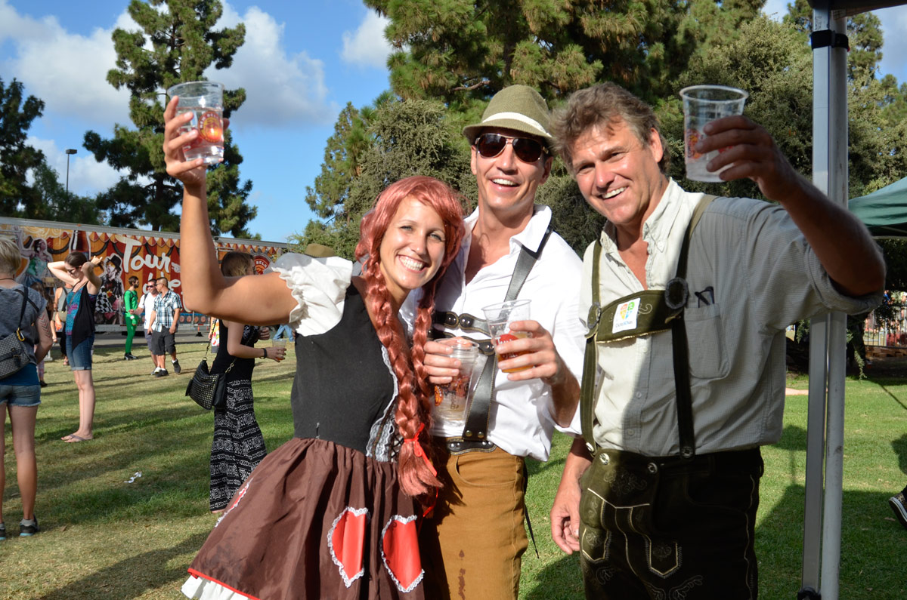
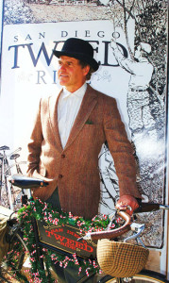
We Remember
We remember and dedicate this report to:
Johan Wangbichler…Hans
ADVOCATE • EDUCATE • CELEBRATE

