Slide 1
ADVOCATE • EDUCATE • CELEBRATE

Slide 2
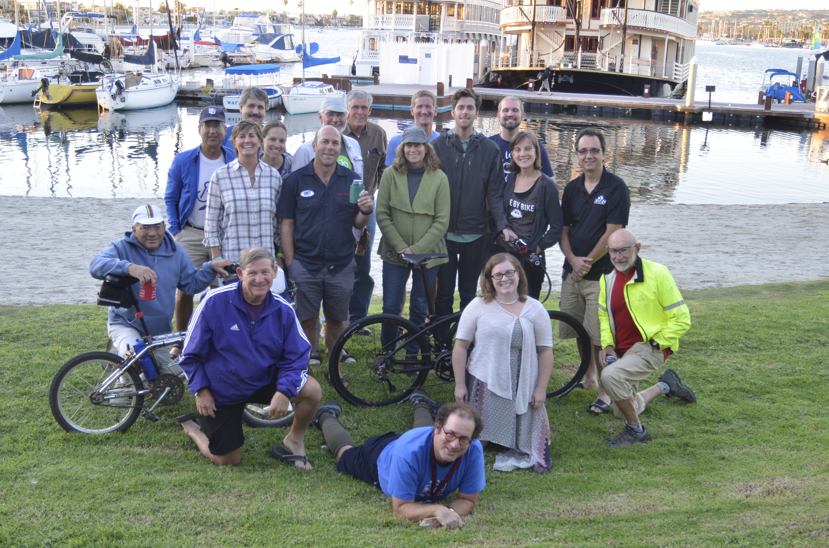
SDCBC BOARD Of Directors
ADVOCATE • EDUCATE • CELEBRATE

Slide 3
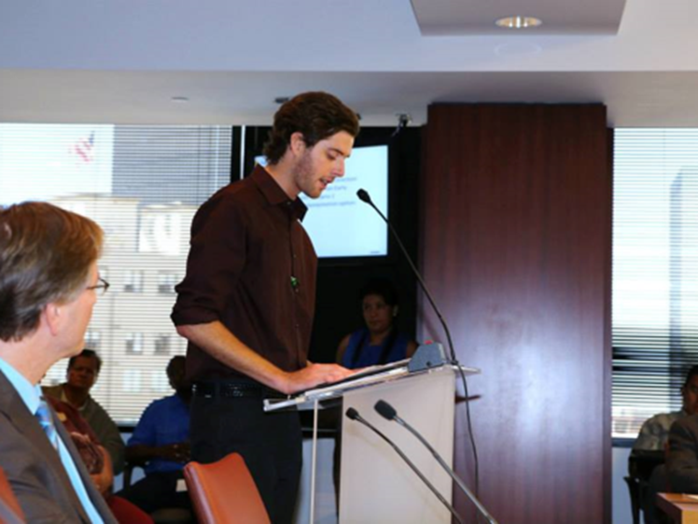
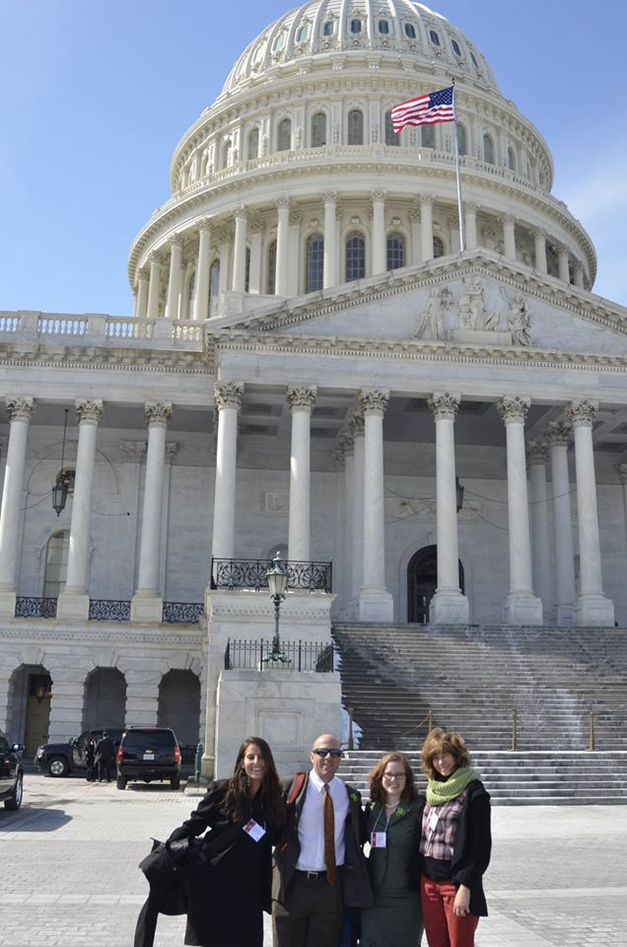
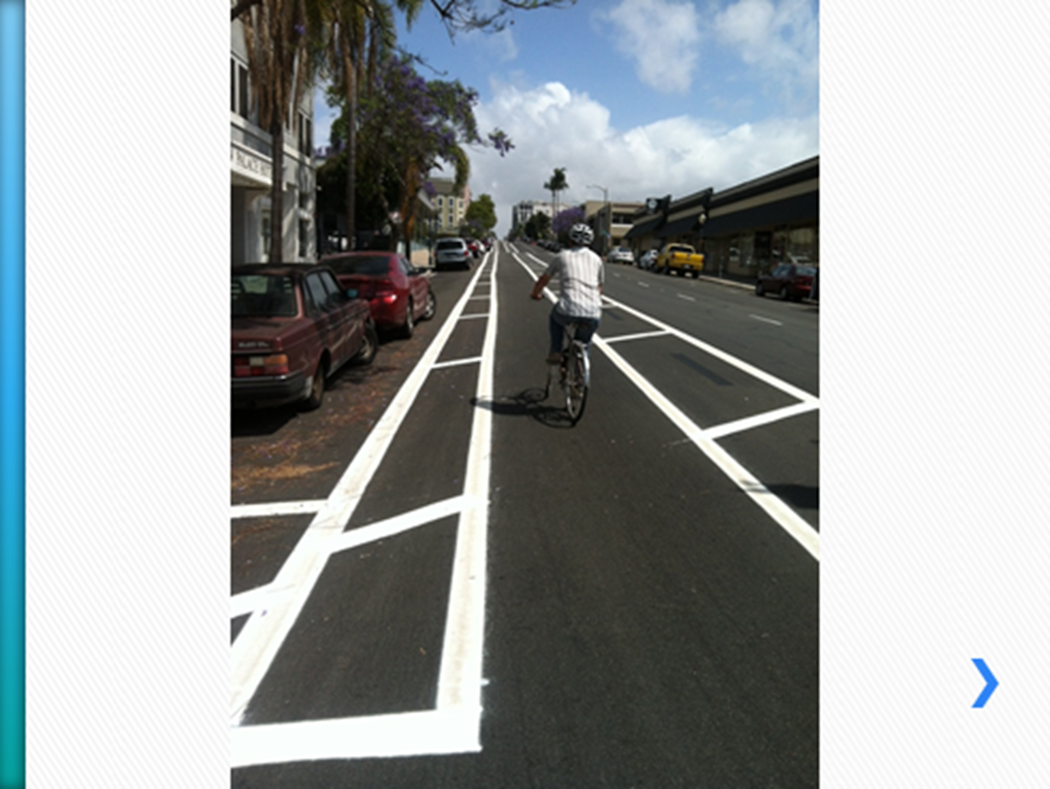
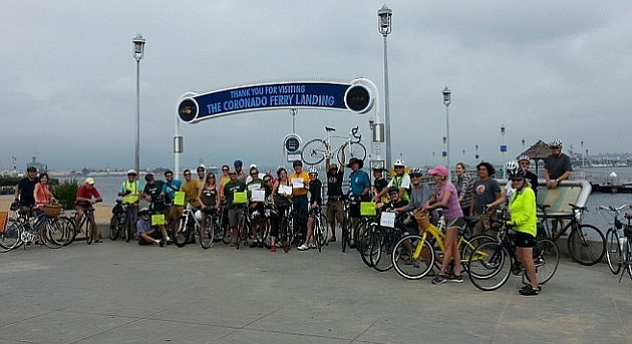
ADVOCACY
ADVOCATE • EDUCATE • CELEBRATE

Slide 4
SDCBC ADVOCACY RESOURCES
Membership (updates)
E-News, letters, social media
Campaigns
E-Mail Advocacy ALERTS (calls to action via Council Dist., Planning Group, City, etc.
Advocacy Committee (2nd Wednesday of Month – Courier Collective)
Regional Bike Walk Alliance
Bicycle Clubs (Council of Clubs)
Media opportunities
Events – Bike The Bay, Tour de Fat
CicloSDias!

Slide 5
LOCAL/REGIONAL ADVOCACY RESOURCES
SANDAG Board, Transportation and Active Transportation Working Group (Public meetings)
Caltrans BPAC
Local Bicycle Advisory Committees

Slide 6
State/National Advocacy Resources

